Slide 1
Chi-Square Tests

Slide 2
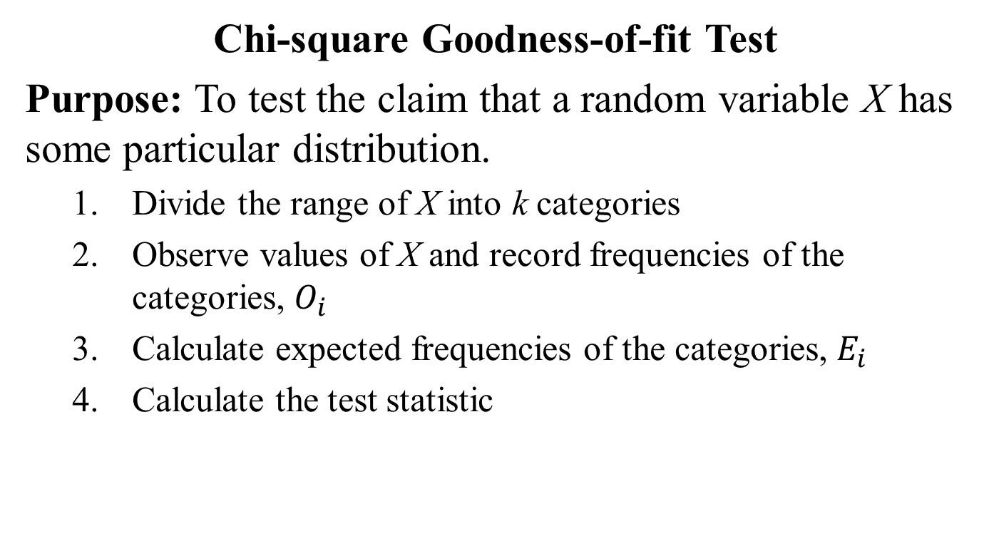
Goodness-of-fit Test
Chi-square Goodness-of-fit Test
Purpose: To test the claim that a random variable X has some particular distribution.
Divide the range of X into k categories
Observe values of X and record frequencies of the categories, $O_{i}$
Calculate expected frequencies of the categories, $E_{i}$
Calculate the test statistic

Slide 3
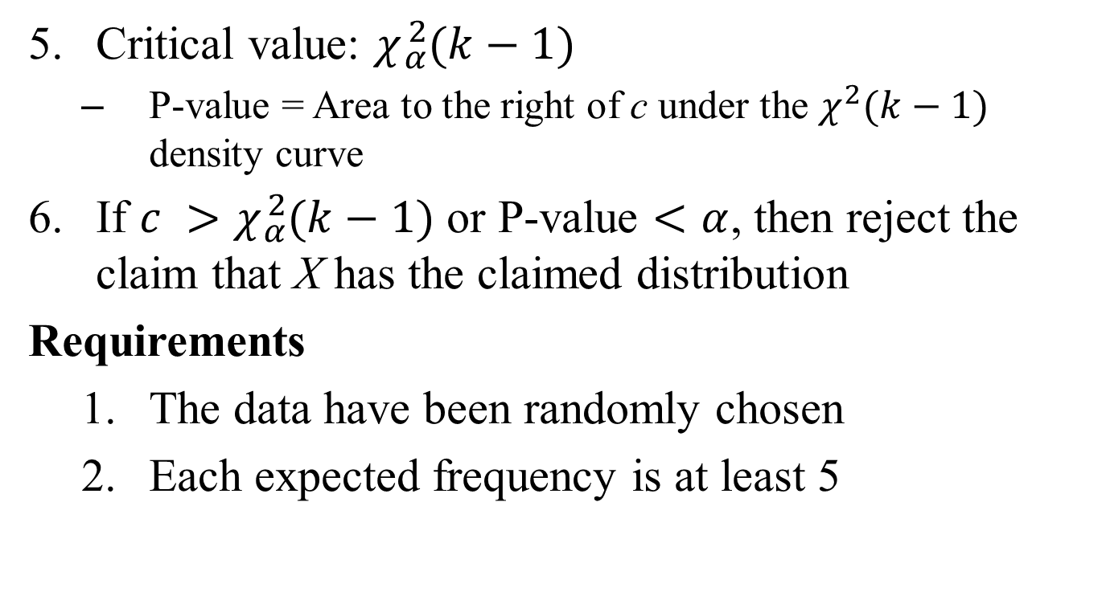
Chi-square Goodness-of-fit Test
Critical value: $χ{}_{α}^{2}{(k−1)}$
P-value = Area to the right of c under the $χ^{2}(k−1)$ density curve
If $c >χ{}_{α}^{2}{(k−1)}$ or P-value $<α$, then reject the claim that X has the claimed distribution
Requirements
The data have been randomly chosen
Each expected frequency is at least 5

Slide 4
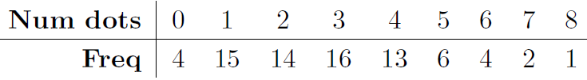
Example
A student simulated dandelions in a lawn by randomly placing 300 dots on a piece of paper with an area of 100 in². He then randomly chose 75 different 1 in² sections of paper and counted the number of dots in each section.

Slide 5
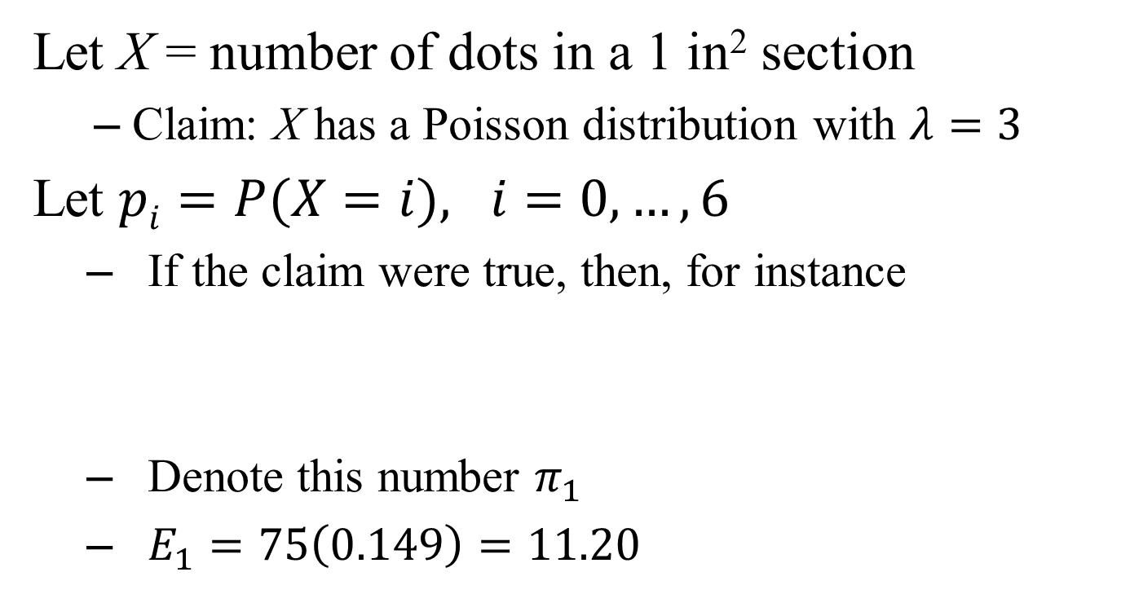
Example
Let X = number of dots in a 1 in² section
Claim: X has a Poisson distribution with $λ=3$
Let $pi=P(X=i), i=0,…,6$
If the claim were true, then, for instance
Denote this number $π_{1}$
$E_{1}=75\left(0.149\right)=11.20$

Slide 6
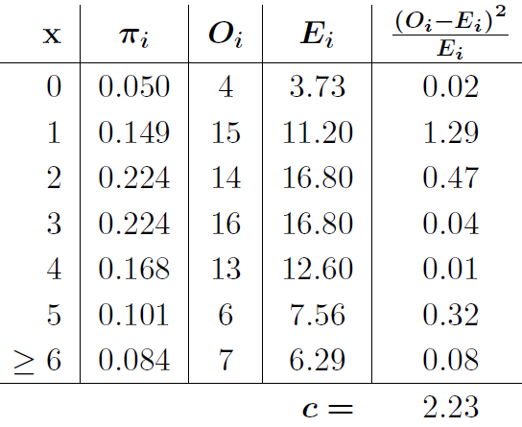
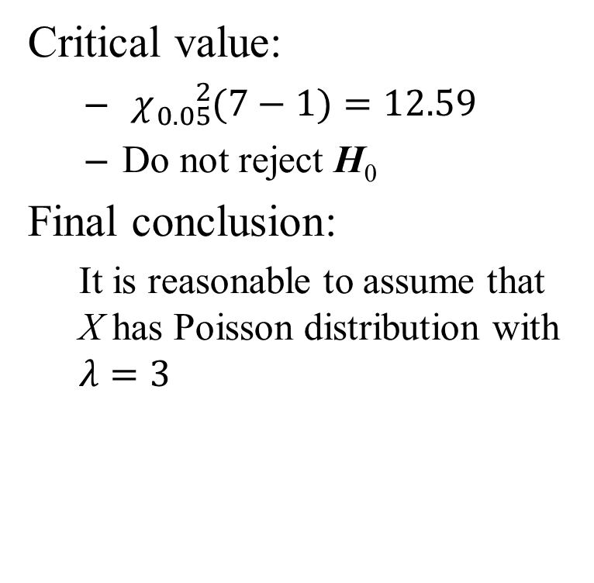
Example
Critical value:
$χ{}_{0.05}^{2}{(7−1)}=12.59$
Do not reject H₀
Final conclusion:
It is reasonable to assume that X has Poisson distribution with $λ=3$

Slide 7
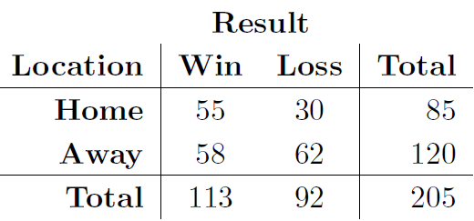
Test of Independence
Two students want to determine if their university men’s basketball team benefits from home-court advantage. They randomly select 205 games played by the team and record if each one was played at home or away and if the team won or lost (data collected by Emily Hudgins and Courtney Santistevan, 2009).
“Contingency Table”

Slide 8
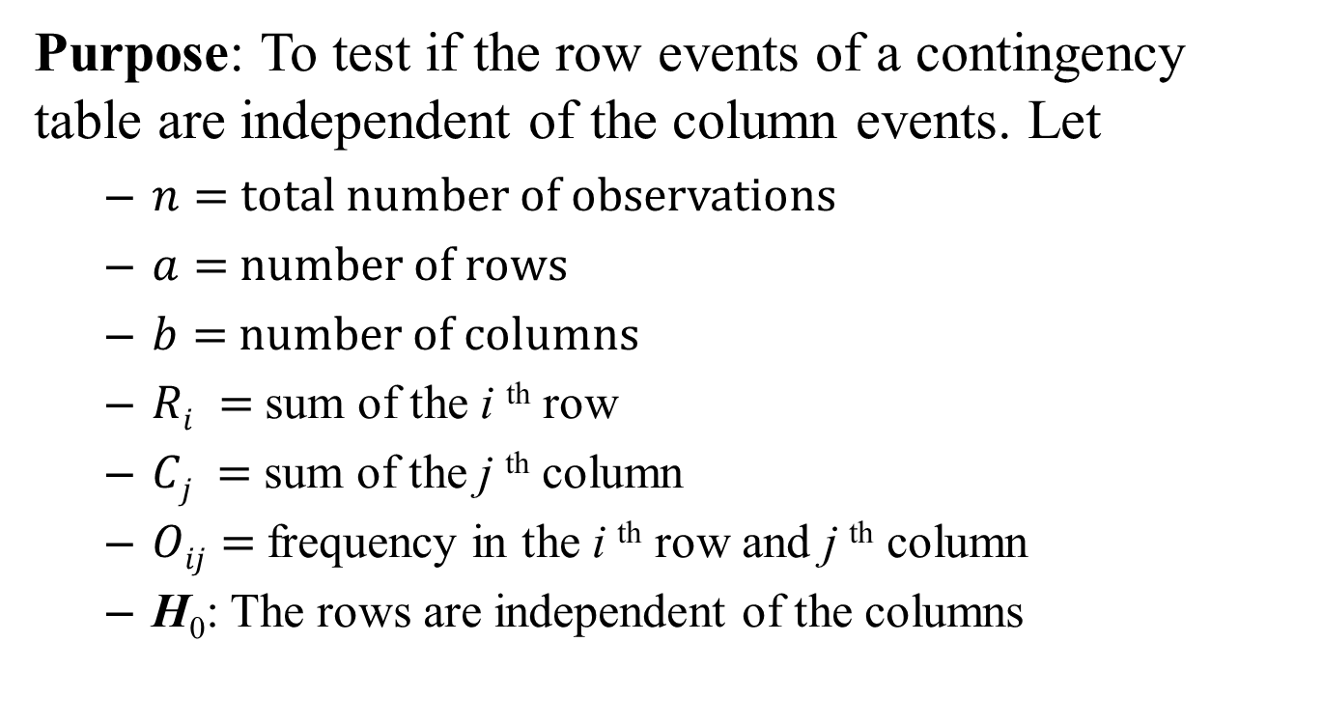
Chi-square Test of Independence
Purpose: To test if the row events of a contingency table are independent of the column events. Let
$n=$total number of observations
$a=$number of rows
$b=$number of columns
$Ri =$sum of the i ^{th} row
$Cj =$sum of the j ^{th} column
$Oij=$frequency in the i ^{th} row and j ^{th} column
H₀: The rows are independent of the columns

Slide 9
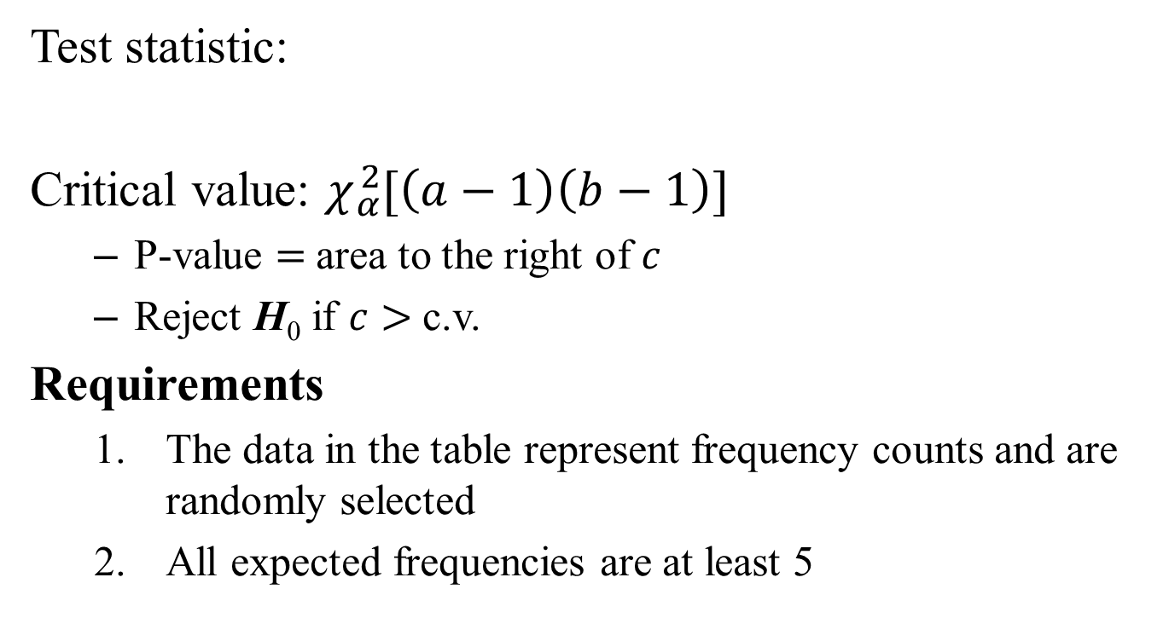
Test of Independence
Test statistic:
Critical value: $χ{}_{α}^{2}{[\left(a−1\right)\left(b−1\right)]}$
P-value $=$area to the right of $c$
Reject H₀ if $c>$c.v.
Requirements
The data in the table represent frequency counts and are randomly selected
All expected frequencies are at least 5

Slide 10
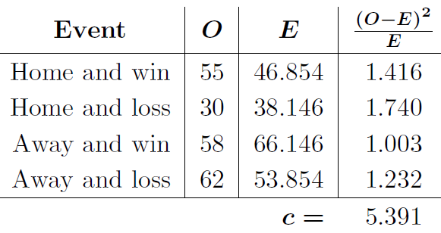
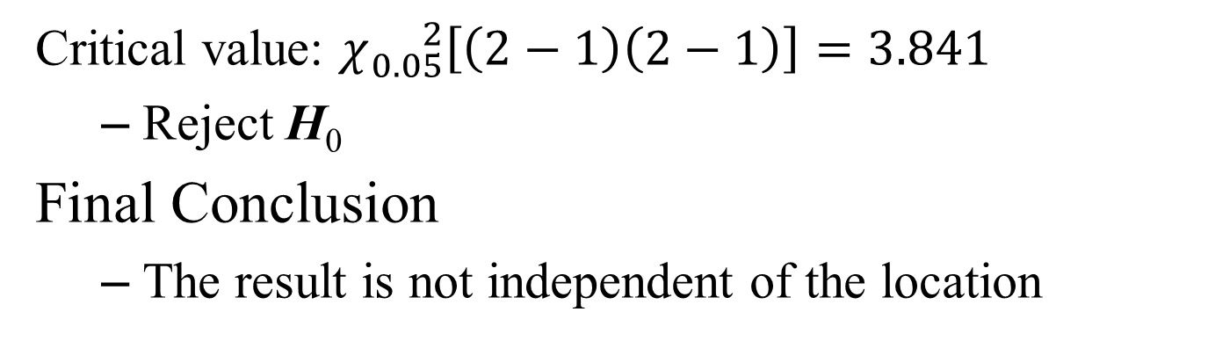
Example
Critical value: $χ{}_{0.05}^{2}{\left[\left(2−1\right)\left(2−1\right)\right]=3.841}$
Reject H₀
Final Conclusion
The result is not independent of the location

Slide 11
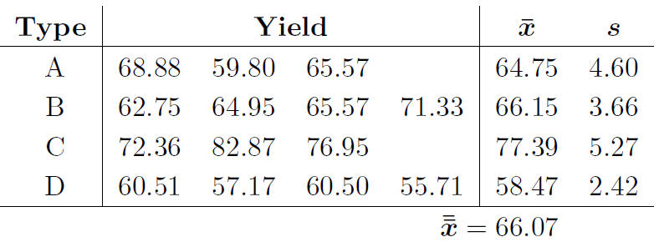
One-way ANOVA
A seed company plants four types of new corn seed on several plots of land and records the yield (in bushels/acre) of each plot as shown below. Test the claim that the four types of seed produce the same mean yield.

Slide 12

One-way ANOVA
Purpose: To test for equality of two or more populations means
Null hypothesis: H₀: $μ_{1}= ⋯=μ_{k}$
$N=$total number of data values
Test statistic

Slide 13
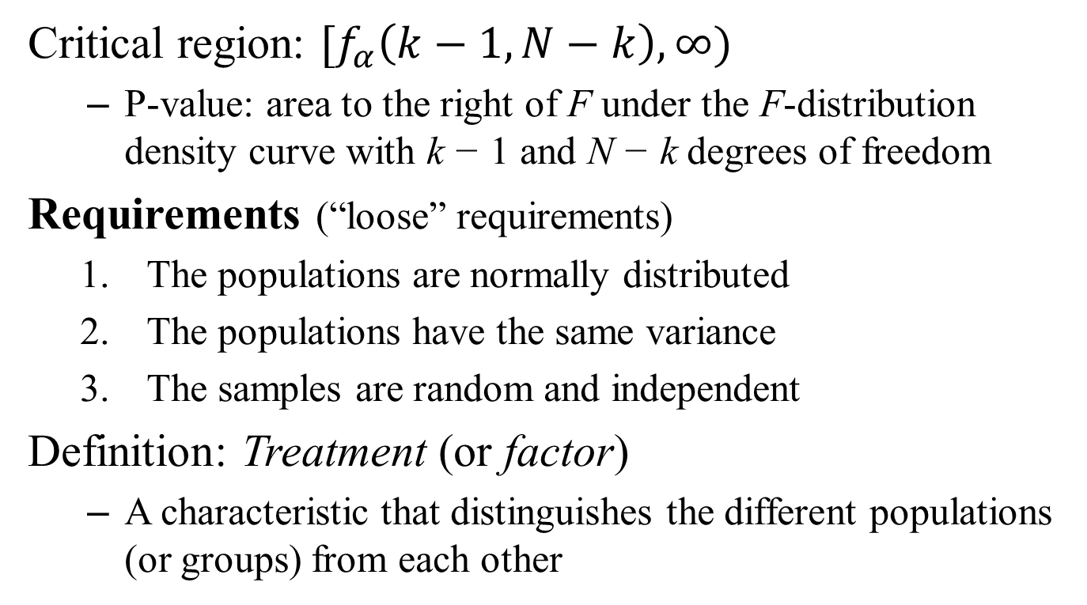
One-way ANOVA
Critical region: $[f_{α}\left(k−1, N−k\right), ∞)$
P-value: area to the right of F under the F-distribution density curve with k − 1 and N − k degrees of freedom
Requirements (“loose” requirements)
The populations are normally distributed
The populations have the same variance
The samples are random and independent
Definition: Treatment (or factor)
A characteristic that distinguishes the different populations (or groups) from each other

Slide 14


Example
Let $μ_{1}=$ mean yield of Type A, etc
H₀: $μ_{1}= μ_{2}=μ_{3}=μ_{4}$ H₁: At least one mean is different
Critical region
$$\left[f_{0.05}\left(4−1, 14−4\right), ∞\right)=[3.71, ∞)$$
- Reject H₀
Final conclusion: The data do not support the claim of equal means

Slide 15
Two-way ANOVA
Randomized Block Design
A statistics professor is comparing four different delivery methods for her introduction to statistics class: face-to-face, online, hybrid, and video (called the treatments).
She divides the population of students into three groups according to their overall GPA: high, middle, and low. (called blocks)
She randomly chooses four students from each block and randomly assigns each one to a class using one of the delivery methods
At the end of the semester she records each student’s overall grade

Slide 16
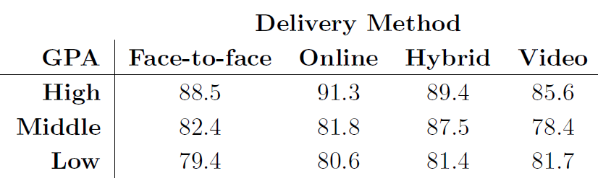
Two-way ANOVA
Two questions:
Do the four treatments have the same population mean?
Do the blocks have any affect on the scores?

Slide 17
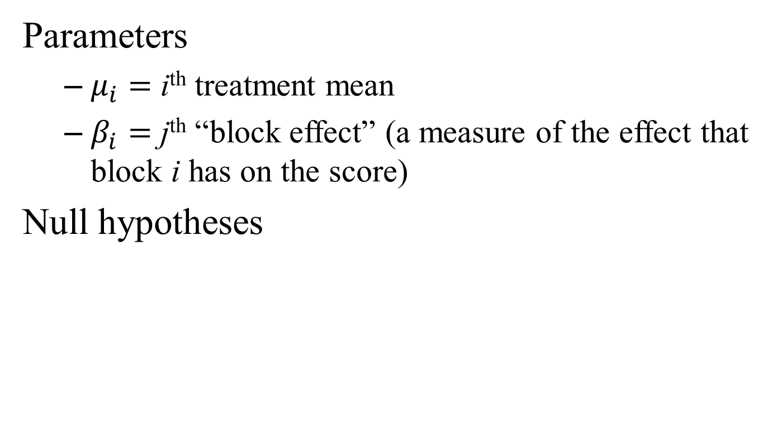
Two-way ANOVA
Parameters
$μ_{i}=$ i^{th} treatment mean
$β_{i}=$ j^{th} “block effect” (a measure of the effect that block i has on the score)
Null hypotheses

Slide 18
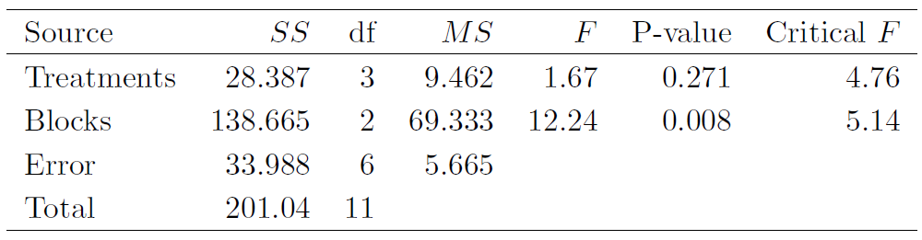
ANOVA Table
P-value = 0.271 – Do not reject H₀
There is not a statistically significant difference between the treatment means
P-value = 0.008 – Reject H_{B}
There is a statistically significant difference in the block effects

Slide 19
Factorial Experiment
The statistics professors randomly chooses 16 students from each GPA level, randomly assigns four to each delivery method, and records their scores at the end of the semester.
Three questions:
Is there any difference between the population mean scores of the delivery methods?
Does the GPA level affect the scores?
Does the interaction of the delivery method and GPA level affect the scores?

Slide 20
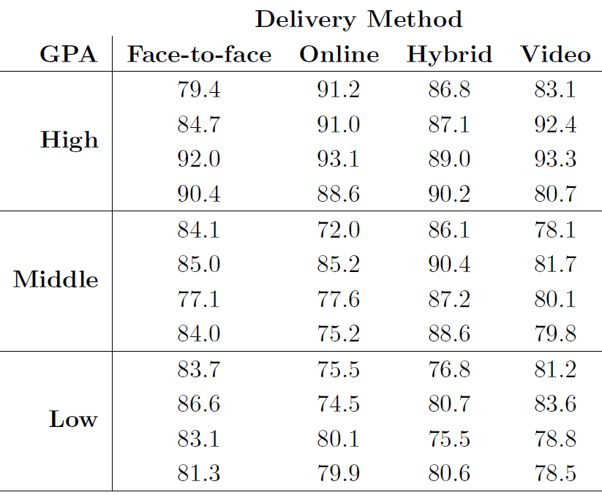
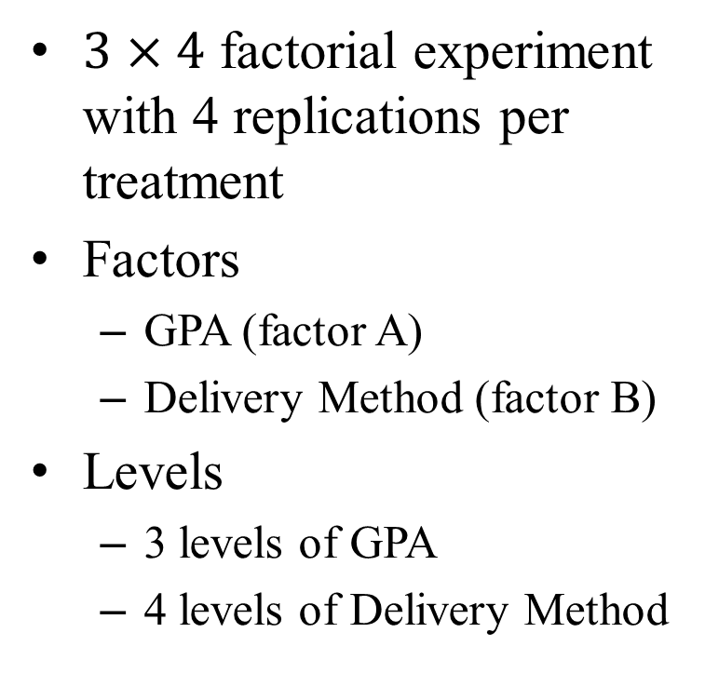
Factorial Experiment
$3×4$ factorial experiment with 4 replications per treatment
Factors
GPA (factor A)
Delivery Method (factor B)
Levels
3 levels of GPA
4 levels of Delivery Method

Slide 21
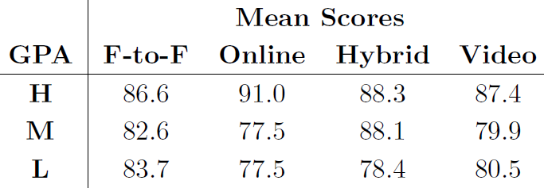
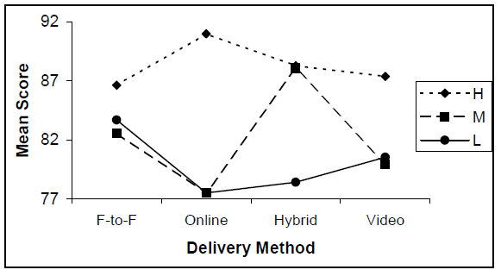
Factorial Experiment

Slide 22
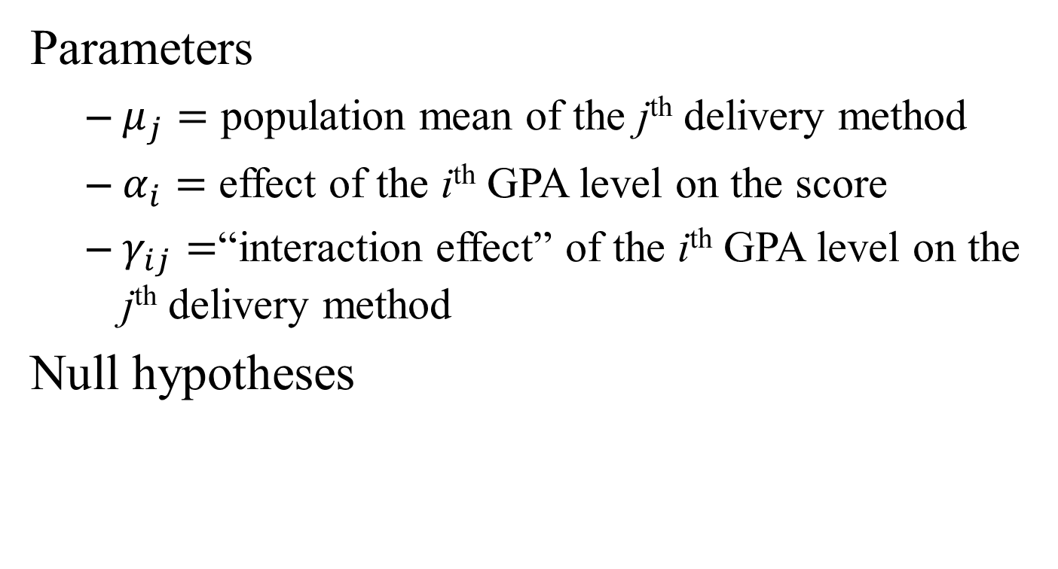
Factorial Experiment
Parameters
$μ_{j}=$ population mean of the j^{th} delivery method
$α_{i}=$ effect of the i^{th} GPA level on the score
$γ_{ij}=$“interaction effect” of the i^{th} GPA level on the j^{th} delivery method
Null hypotheses

Slide 23
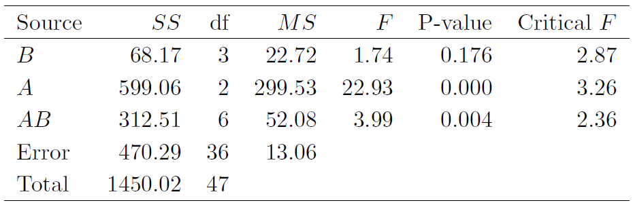
ANOVA Table
P-value = 0.176 – Do not reject H_{B}
There is not a statistically significant difference between the means of the delivery methods
P-value = 0.000 – Reject H_{A}
There is a statistically significant difference in the effects of the GPA levels

Slide 24
ANOVA Table
P-value = 0.004 – Reject H_{AB}
There is a statistically significant difference in the interaction effects
Overall
There is not a “best” method
Consider certain delivery methods to certain GPA levels

